Slide 1
Open Source is the Way Forward for Mainframe
A look at the work and impact of the Open Mainframe Project
Notes:
In this talk, we will focus on how forward thinking enterprises leverage hybrid infrastructure rather than any one approach to their IT infrastructure. In the past several years, more and more organizations use their computing infrastructure as a strategic advantage; buying off the shelf they view is keeping them at the same level as their competitors, but leveraging computing infrastructure that solves their business problems specifically helps them be more efficient and better engage their customers.

Slide 2
Opportunity:
Accelerate mainframe innovation with open and collaborative development
But how?
Notes:
There are two key reasons on why open source for mainframe - it accelerates innovation and is more secure.

Slide 3
Antitrust Policy Notice
Linux Foundation meetings involve participation by industry competitors, and it is the intention of the Linux Foundation to conduct all of its activities in accordance with applicable antitrust and competition laws. It is therefore extremely important that attendees adhere to meeting agendas, and be aware of, and not participate in, any activities that are prohibited under applicable US state, federal or foreign antitrust and competition laws.
Examples of types of actions that are prohibited at Linux Foundation meetings and in connection with Linux Foundation activities are described in the Linux Foundation Antitrust Policy available at linuxfoundation.org/antitrust-policy. If you have questions about these matters, please contact your company counsel, or if you are a member of the Linux Foundation, feel free to contact Andrew Updegrove of the firm of Gesmer Updegrove LLP, which provides legal counsel to the Linux Foundation.

Slide 4
Antitrust Policy Notice
Linux Foundation meetings involve participation by industry competitors, and it is the intention of the Linux Foundation to conduct all of its activities in accordance with applicable antitrust and competition laws. It is therefore extremely important that attendees adhere to meeting agendas, and be aware of, and not participate in, any activities that are prohibited under applicable US state, federal or foreign antitrust and competition laws.
Examples of types of actions that are prohibited at Linux Foundation meetings and in connection with Linux Foundation activities are described in the Linux Foundation Antitrust Policy available at linuxfoundation.org/antitrust-policy. If you have questions about these matters, please contact your company counsel, or if you are a member of the Linux Foundation, feel free to contact Andrew Updegrove of the firm of Gesmer Updegrove LLP, which provides legal counsel to the Linux Foundation.
Open Mainframe Project is a pre-competitive platform that enables cooperation and leveraged development.

Slide 5
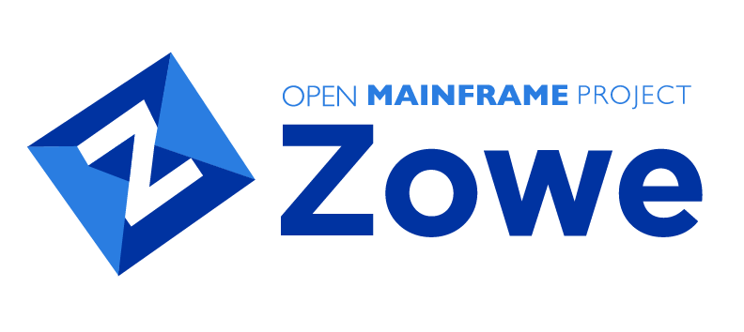
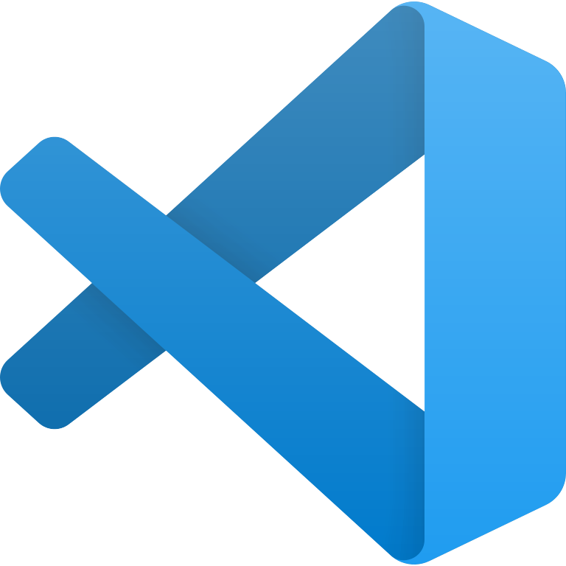

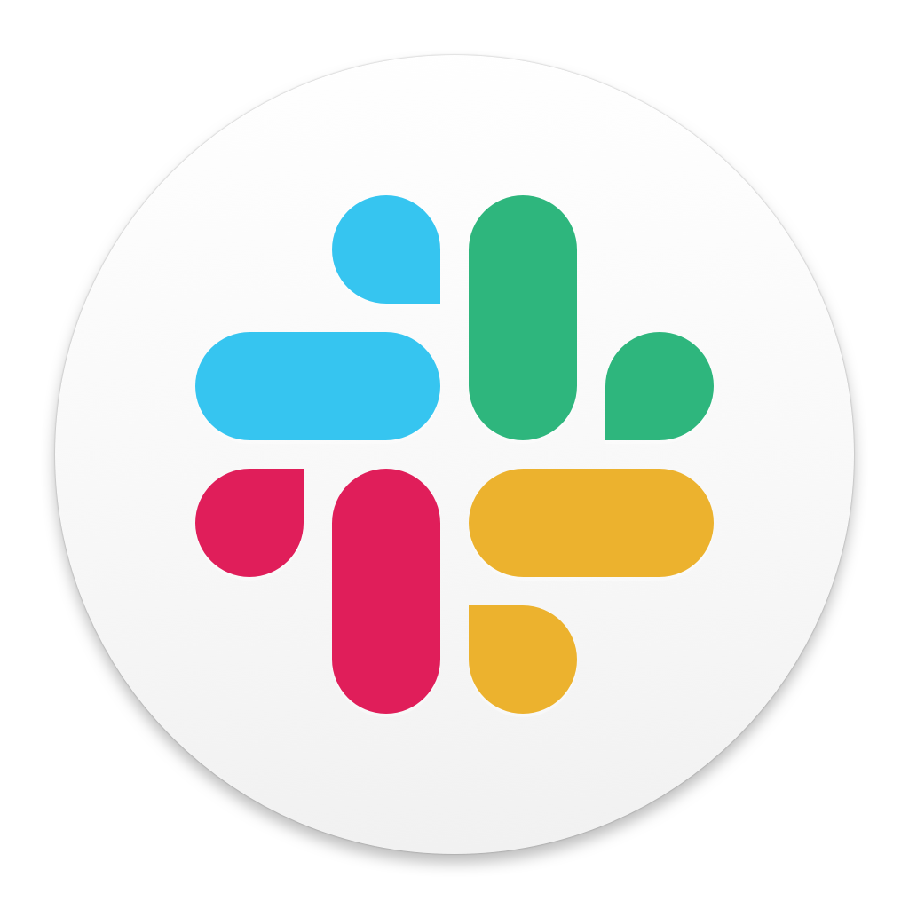
Example: Leveraging Zowe Create Efficiencies
Value Added Solutions
Value Added Solutions
Custom Integration Layer
(UI, App Integrations, APIs)
Zowe Explorer
Zowe Desktop
(Web UI interface)
Dev SDKs
(Java,JS,Python,Swift)
Zowe Chat
Zowe CLI
(CLI interface for scripting)
Zowe API Mediation Layer
(RESTful API gateway - Security)
Core Application
Core Application
Without Zowe
Full stack supported and developed; expensive R&D and hard to scale
With Zowe
Focus on Core Application and leverage Zowe components to better integrate with DevOps workflows

Slide 6
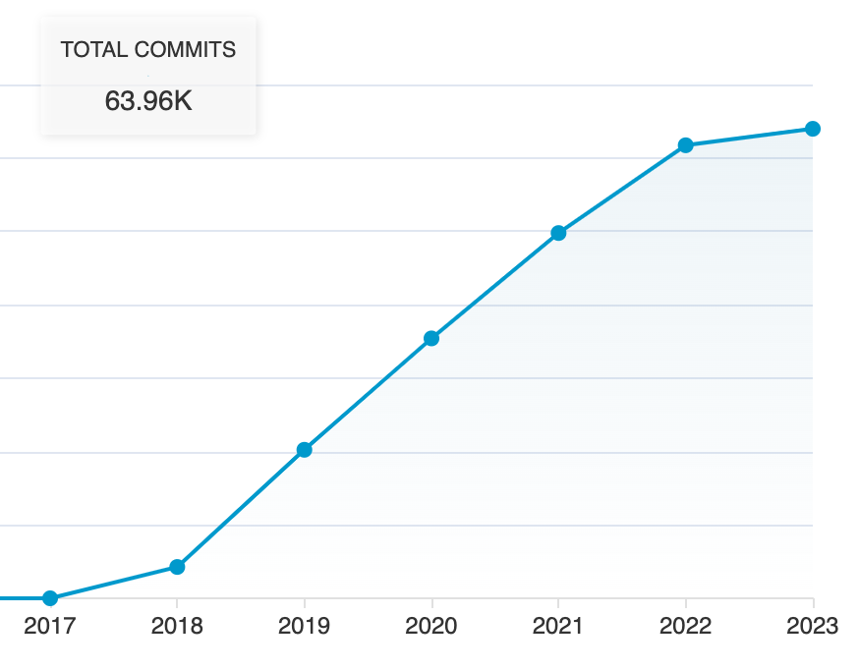
Cost to Create Zowe
Total Physical Source Lines of Code (SLOC)
272,536
Development Effort Estimate
64.81 (777.68) Person-Years (Person-Months)
(Basic COCOMO model, Person-Months = 2.4 * (KSLOC**1.05))
Schedule Estimate
1.70 (20.46) Years (Months)
(Basic COCOMO model, Months = 2.5 * (person-months**0.38))
Total Estimated Cost to Develop
$8,754,452
(average salary = $56,286/year, overhead = 2.40).
generated using David A. Wheeler's 'SLOCCount'

Slide 7
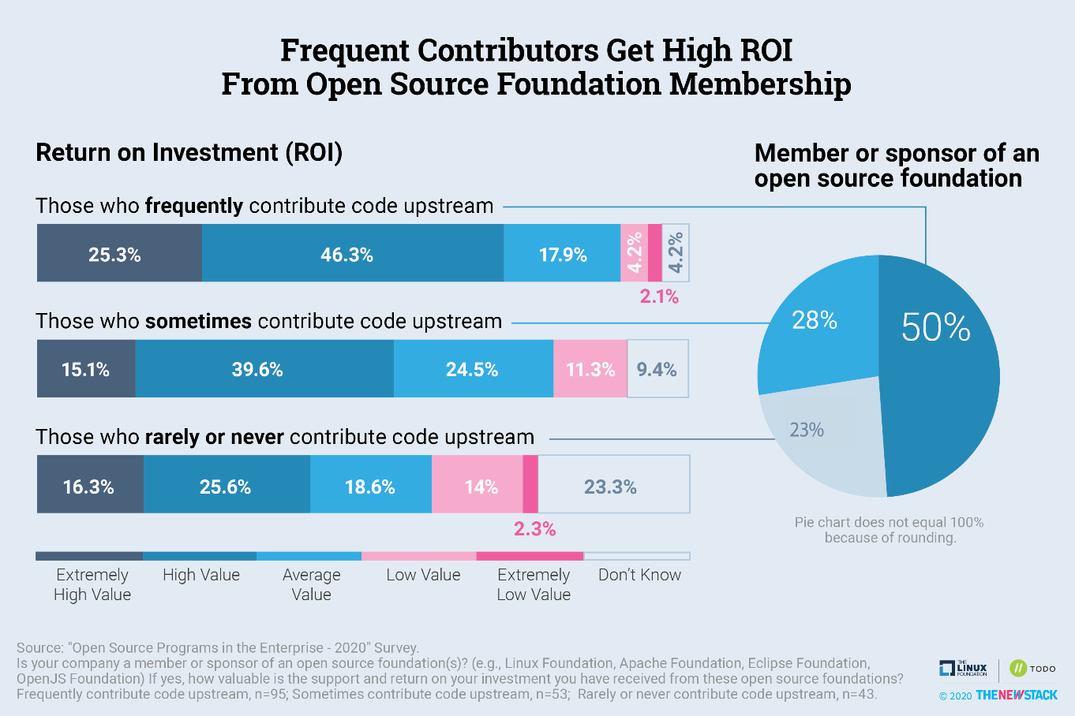

Slide 8
Value of Leveraging Development
Let’s say an organization accounts for 30% of contributions (3x multiplier in value as a leading organization⁽¹⁾)
This means the organization invested…
19.2 years of developer effort
$2.6M of R&D costs
and leveraged (3x multiplier⁽¹⁾)…
175.2 years of developer effort
$23.6M of R&D costs
Source: https://www.mckinsey.com/industries/technology-media-and-telecommunications/our-insights/developer-velocity-how-software-excellence-fuels-business-performance#
9x R&D ROI

Slide 9

Example: Leveraging Feilong Create Efficiencies
Value Added Solutions
Value Added Solutions
Custom Integration Layer
(UI, App Integrations, APIs)
SDK REST Interface, API, Server
z/VM
z/VM
Without Feilong
Full stack supported and developed; expensive R&D and hard to scale
With Feilong
Vendor/Customer focus on Value Added Solutions, leverage Feilong development

Slide 10
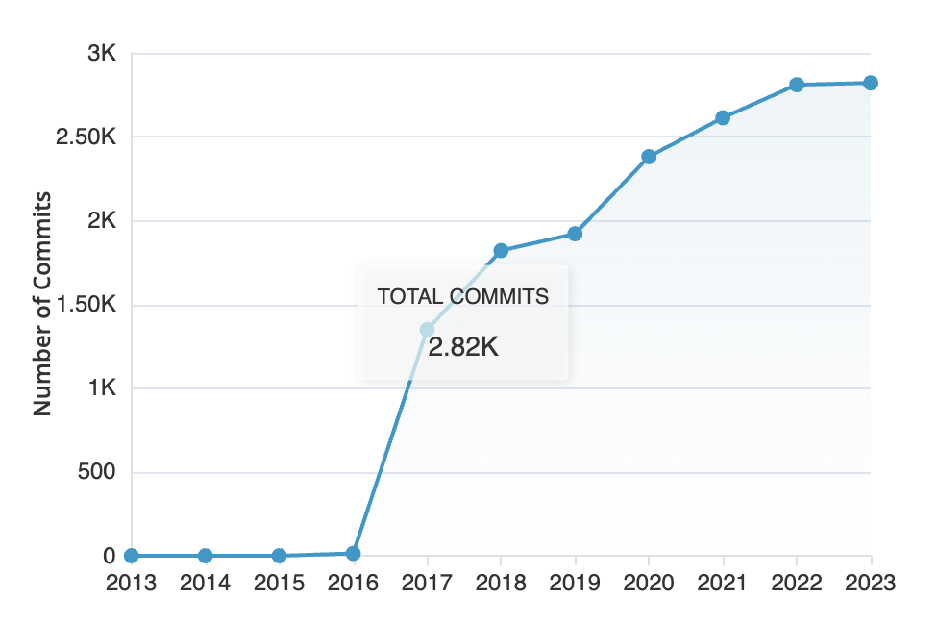
Cost to Create Feilong
Total Physical Source Lines of Code (SLOC)
91,717
Development Effort Estimate
21.82 (261.84) Person-Years (Person-Months)
(Basic COCOMO model, Person-Months = 2.4 * (KSLOC**1.05))
Schedule Estimate
1.38 (16.59) Years (Months)
(Basic COCOMO model, Months = 2.5 * (person-months**0.38))
Total Estimated Cost to Develop
$2,947,620
(average salary = $56,286/year, overhead = 2.40).
generated using David A. Wheeler's 'SLOCCount'

Slide 12
Value of Leveraging Development
Let’s say an organization accounts for 30% of contributions (3x multiplier in value as a leading organization⁽¹⁾)
This means the organization invested…
6.55 years of developer effort
$884,286 of R&D costs
and leveraged (3x multiplier⁽¹⁾)…
65.46 years of developer effort
$8.8M of R&D costs
Source: https://www.mckinsey.com/industries/technology-media-and-telecommunications/our-insights/developer-velocity-how-software-excellence-fuels-business-performance
7x R&D ROI

Slide 13
But there are more benefits than just pure R&D
Leadership
Top contributing organizations in best position to drive ecosystem direction.
End-users more likely to work with vendors who are primary contributors and invest in upstream projects.
Supply chain efficiencies
License and security vulnerability management done in upstream project
Partner and developer onboarding can leverage broad community versus specific vendor resources.
Vendor-neutral outreach and training
Technology enablement done at project level
Vendor can focus on specific value adds.
Typical ROI 5x-40x
dependent on membership, staff, and product investment

Slide 14
Challenge:
How can we grow and sustain open source on mainframe?

Slide 15
Successful open collaboration ecosystems comes down to four core factors.
Neutrality
No one company or organization can “take it away” from the community that forms around a project.
IP Clarity
Removal of IP uncertainty enables anyone to get involved as a contributor or implement as a user.
Open Governance Do-ocracy
The most successful projects that have stood the test of time have neutral, open governance models where those who do the work make the decisions in a defined governance model.
Financial Support Ecosystem
Encouraging academic, government, and commercial engagement in leads to jobs, faster adoption, new contributions and features that address new use cases.

Slide 16
Enter Open Mainframe Project
Open Mainframe Project believes…
that leading organizations leverage their technology infrastructure as a competitive advantage.
that the mainframe design principles of security, stability, scalability, and performance are important to these leading organizations
having the mainframe interoperable in a hybrid infrastructure enables leading organizations to realizes it’s benefits.
technical advancements that are needed by the mainframe community can be better achieved through open source.
Notes:
Open Mainframe Project was founded in 2015 to be the focal point for the growth of open source on mainframe.
Take a look at the Open Mainframe Project’s principles.
The project believes that interconnected mainframe happens through open source, and achieving this is only possible as a community effort.

Slide 17
Projects support a continuous, sustainable ecosystem.
Commercial Products/Solutions
Under the LF model projects become part of a continuous, sustainable ecosystem
Sustainable projects have a developer community
A developer community’s technology is used in commercial solutions that profit businesses
The businesses then participate and reinvest back into the project
The businesses then hire developers to work in the community
Neutral Project Governance &
IP Model
Bug Fixes,
Security Updates
Community Development
Commercial dependency drives a virtuous cycle of commercial and community engagement based on accepted governance and IP models

Slide 18
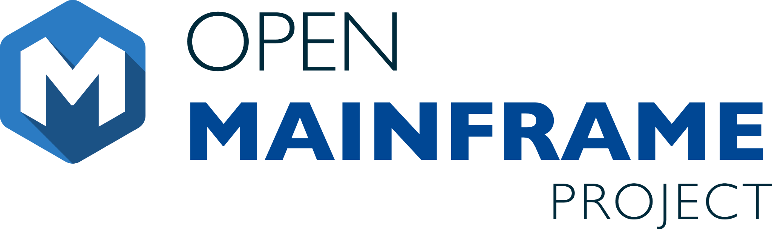




Vision
The mainframe is an active, integrated, and essential part of modern enterprise IT, consumable by mainstream developers and users, and driven by a vibrant open source community.
Mission
To achieve the vision of the Open Mainframe Project by…
The Open Mainframe Project was founded in 2015, as a focal point for deployment and use of Linux and Open Source in a mainframe computing environment.
Open Source is the collective thread within leading organizations that look to leverage their technology infrastructure as a competitive advantage. The mainframe design principles of security, stability, scalability, and performance are important to these leading organizations, and having the mainframe interoperable in a hybrid infrastructure enables leading organizations to realize its benefits. Open Mainframe Project believes this is best achieved as a community through open source.
Open Mainframe Project hosts 17 projects and working groups and is supported by 40 organizations.
Setting a high bar for application development on the mainframe
through documentation, API development, and a security-first approach.
Showcase the mainframe of today
to both the mainframe ecosystem as well as the broad enterprise IT community.
Enable the mainframe to be more consumable by developers
with a transparent experience in leveraging the value propositions of the mainframe.
Ensure the mainframe aligns well in the changing enterprise IT landscape
of cloud-native and DevOps.
Notes:
The mission of the Open Mainframe Project is to build that community and adoption of Open Source on the mainframe, which will ( read points above )
Image from https://www.openmainframeproject.org/about

Slide 19
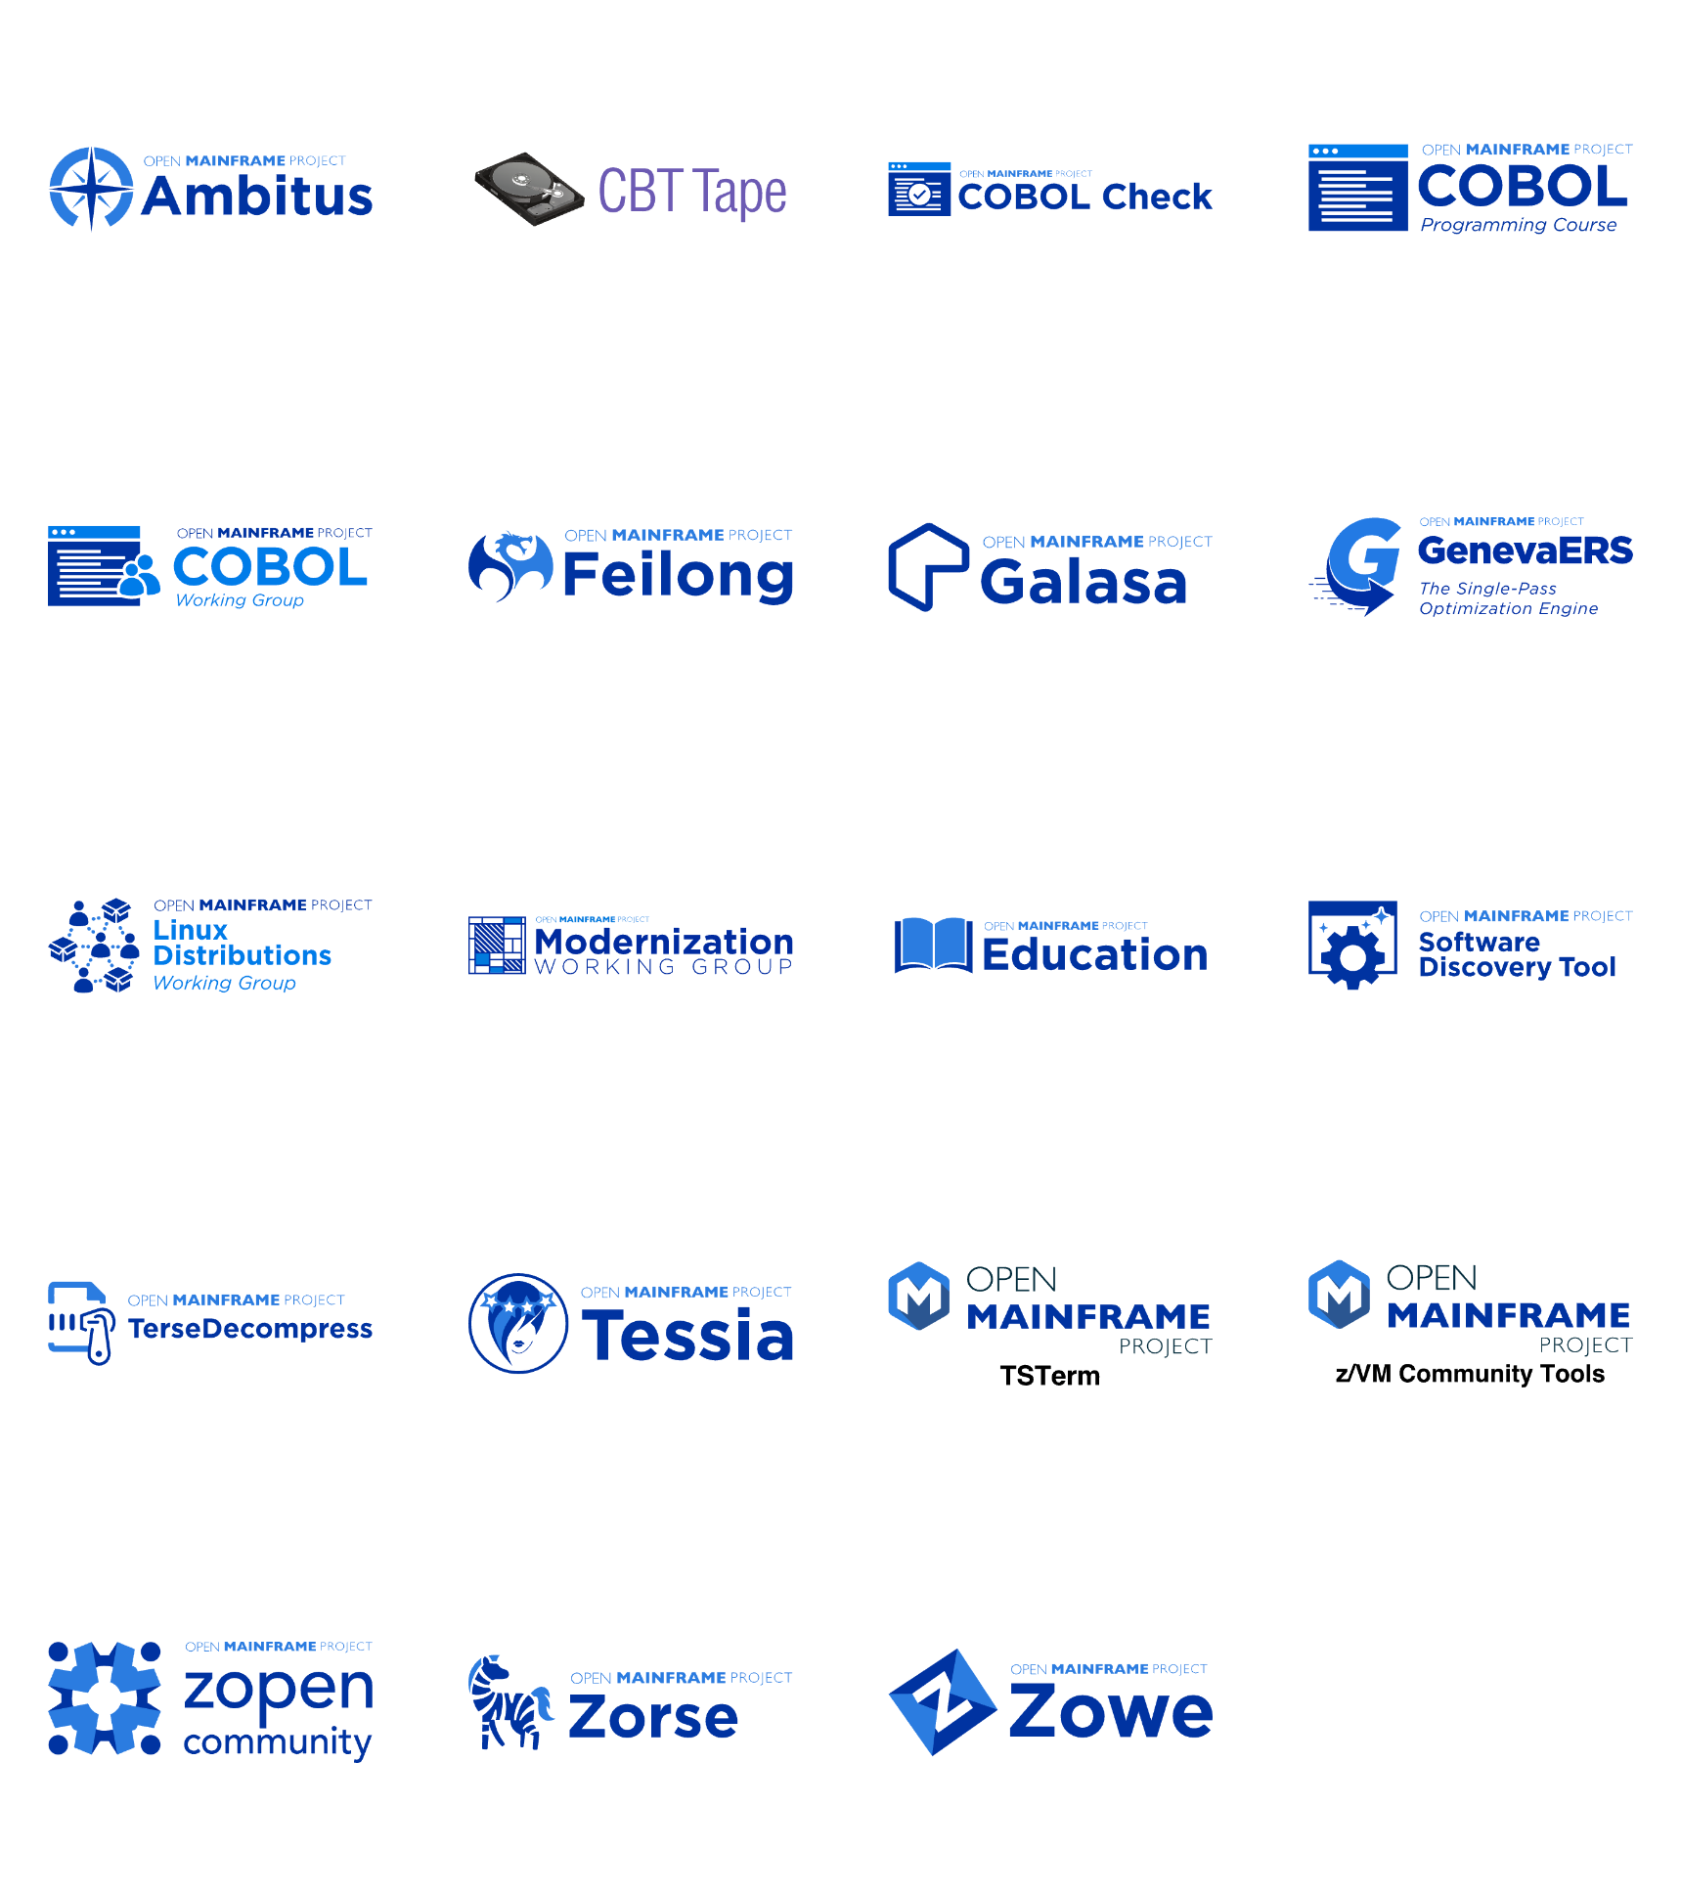
Open Mainframe Project enables this innovation
Learn about all Open Mainframe projects at https://openmainframeproject.org/our-projects/
Notes:
Open Mainframe Project enables this innovation as a host of 16 projects and working groups that are part of closing the gap.
Source: https://landscape.openmainframeproject.org/pages/hosted-projects?style=body{background-color:white;}.borderless-mode%20.mosaic%20.logo{height:100px;}.sh_wrapper%20span{font-size:24px!important;text-decoration:underline;color:black;}%23embedded-footer{display:none;}.borderless-mode%20.mosaic-wrap%20{%20padding:%200px%2010px;}

Slide 20
The LF’s Support Programs help communities succeed.
Developer Community
Release & Infrastructure Support
CI/CD, release engineering, infrastructure, collaboration tools, DNS/web
Developer Engagement
Dev Summits, meetups, events, Hackathons for maintainers and extended dev community
Mentorship
Upskilling for better careers, expanding the pool of developers and next generation leaders
Commercial Ecosystem
Talent & Skills Development
Educational engagement, training courses, professional certifications
Neutral Venue, Global presence
Nonprofit entity, leadership and managers to engage on issues/ideas, neutral governance templates, global entities
Open Standards
Open specifications, ISO standardization path
Resource Funding Options
Ability to infuse resources into a community
Project Maintainers
Security
Security audits, best practices, badges and scanning tools
Facilitation
Neutral managers available to facilitate development and execution on priorities
Project Advocacy
PR/AR, social media, blogs, videos, content creation highlighting their project
OSPO & Legal Professionals
Analytics & Insights
Project health and dependability metrics
OSS Management
TODO Group OSPO peer engagement, OSPO best practices and guides, Legal Summit and peer engagement
Compliance
Process guides, license scanning, export control management, tools for internal use

Slide 21
The Linux Foundation’s goal is to create the greatest shared technology investment in history by enabling open collaboration across companies, developers and users.
We are the nonprofit organization of choice to build ecosystems that accelerate open source technology development and commercial adoption on a global scale.

Slide 22

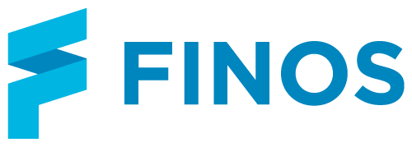
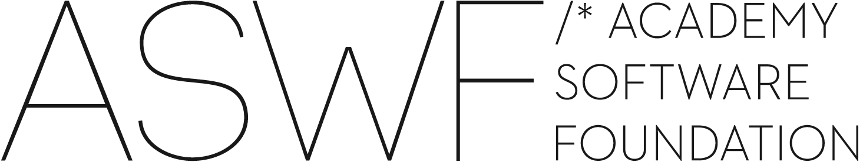

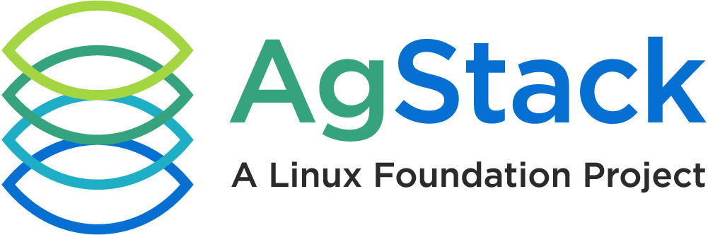
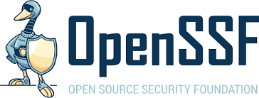

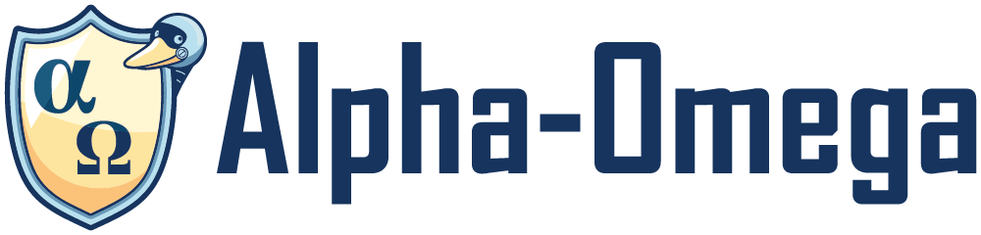

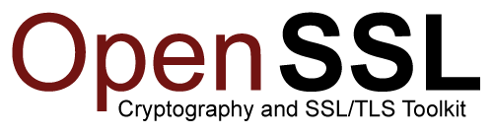

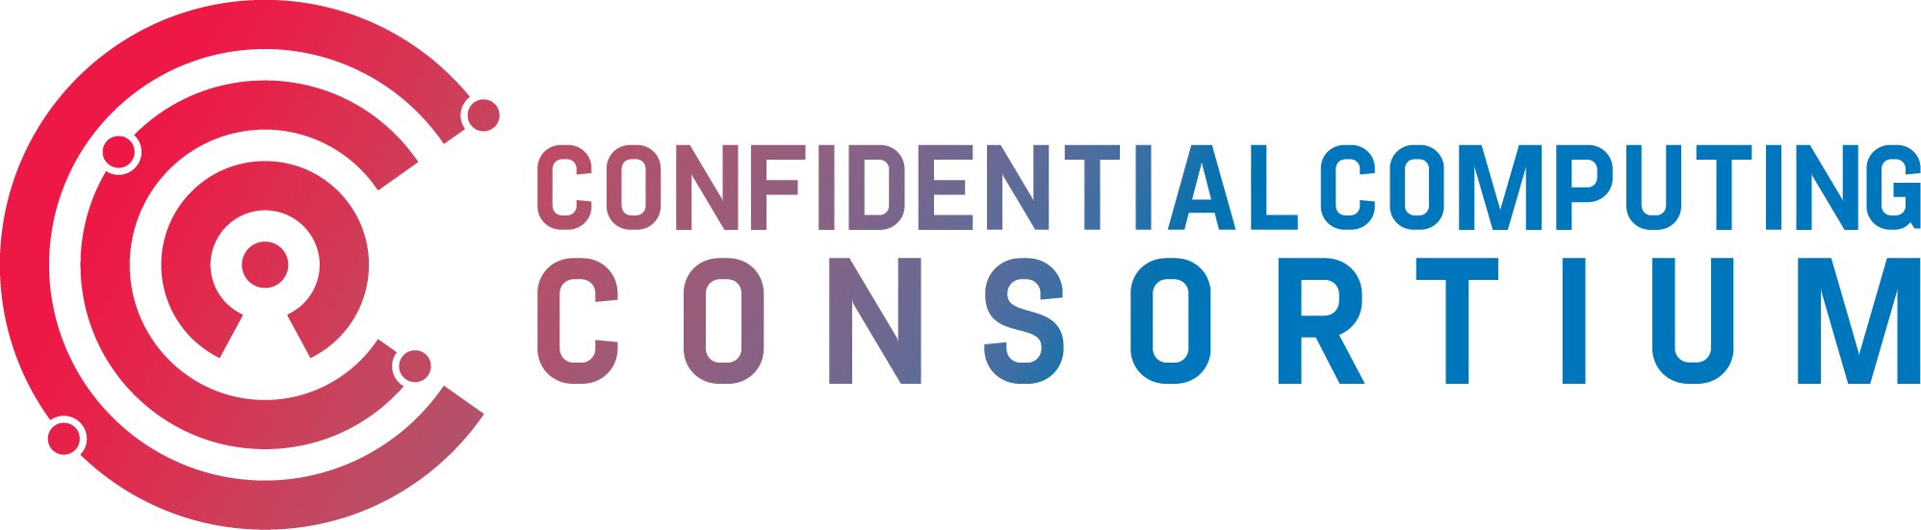

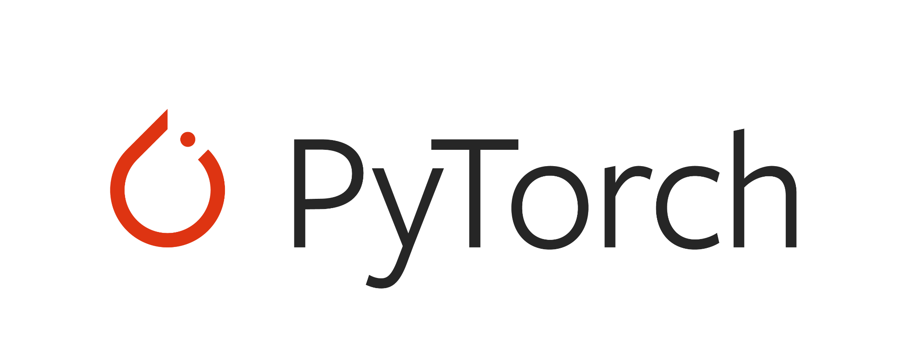
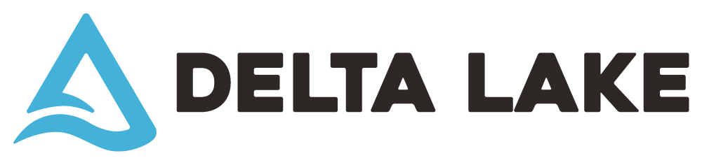
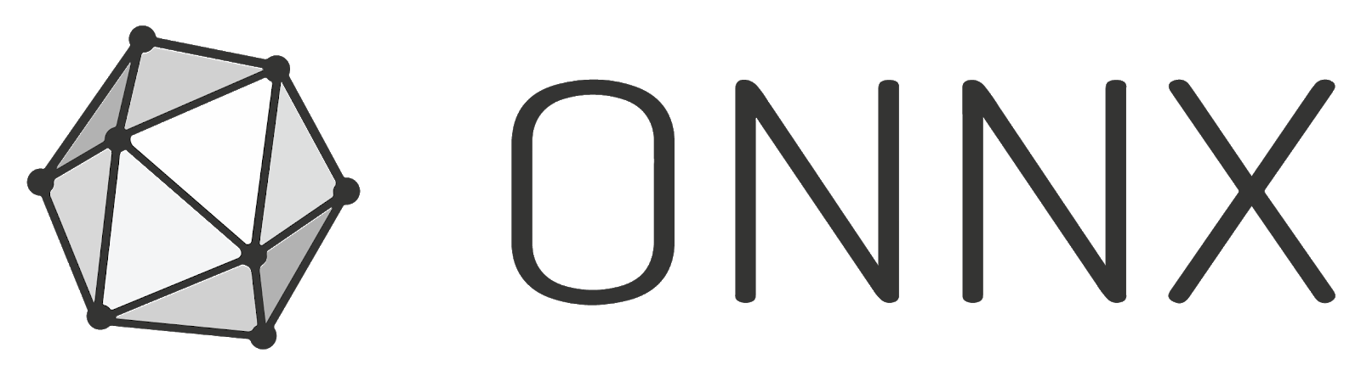
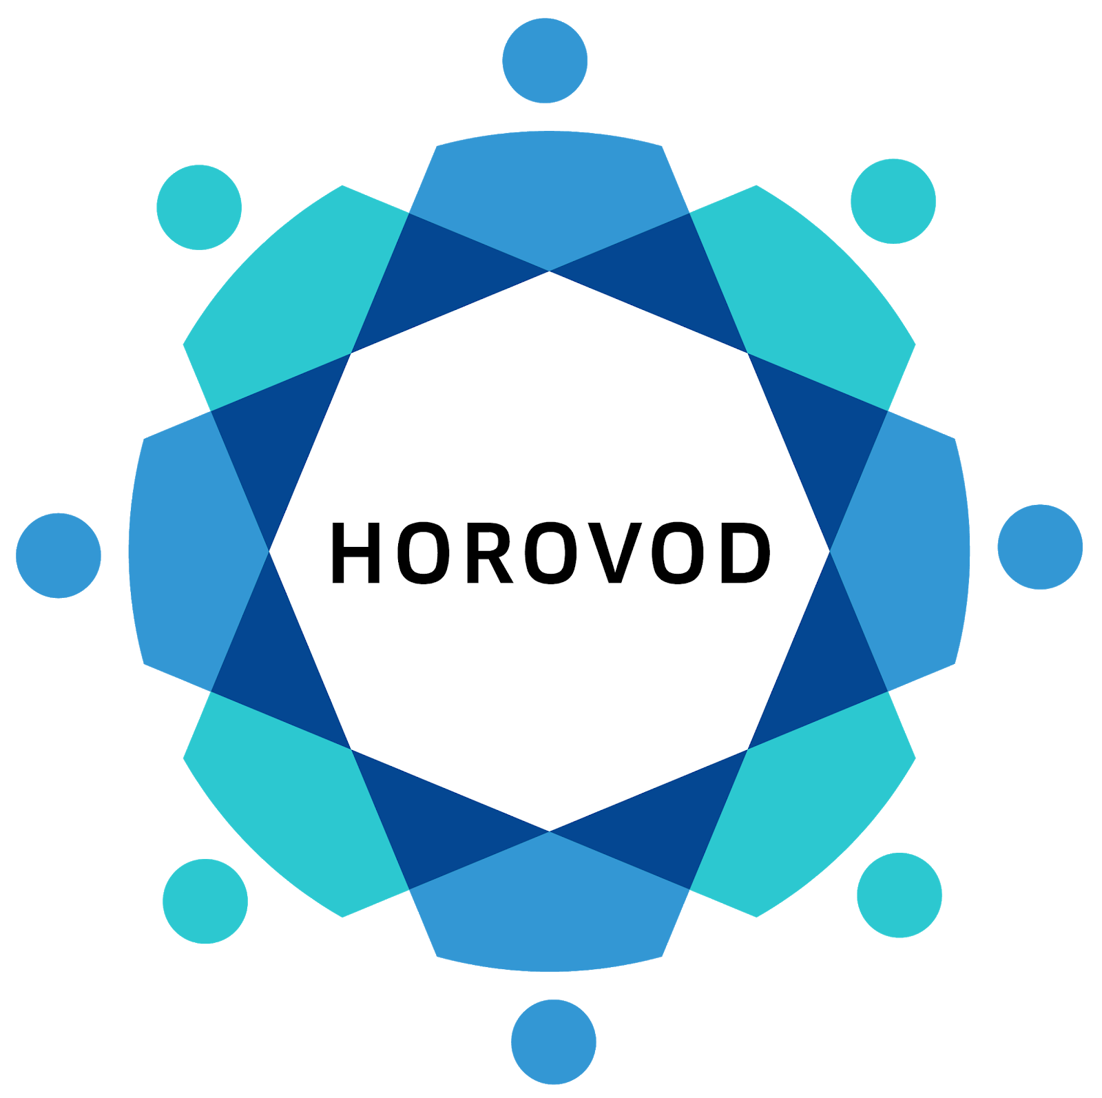
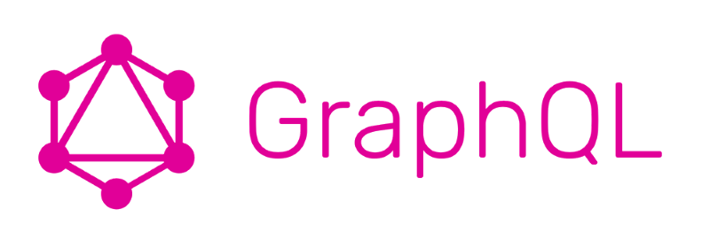
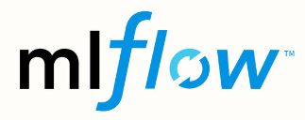


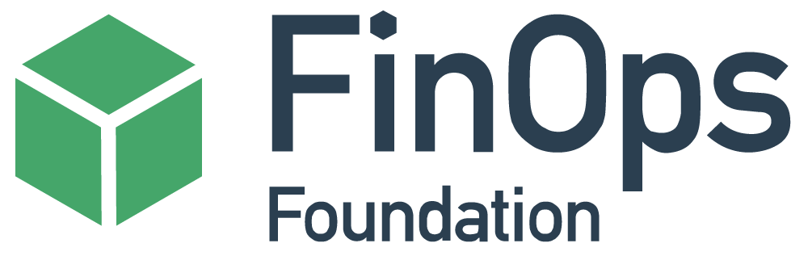
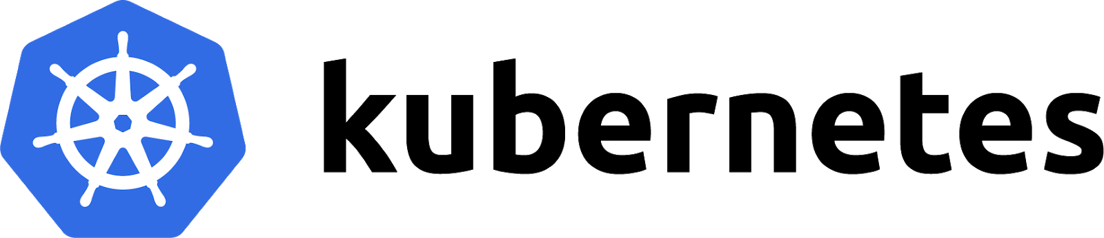
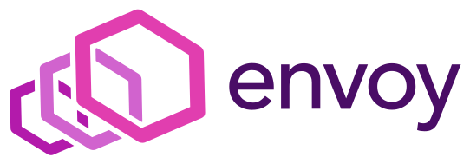
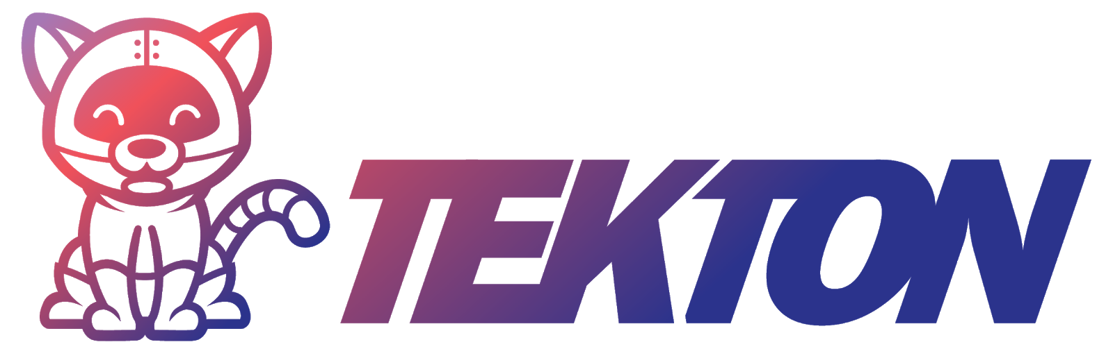
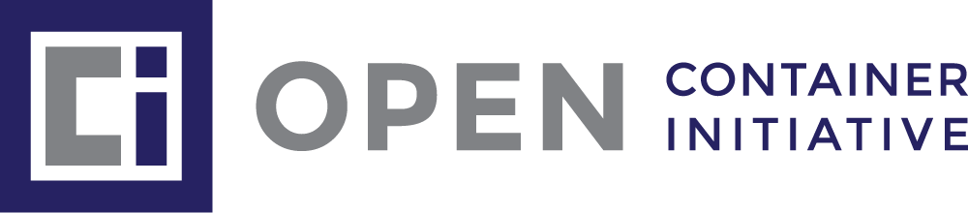
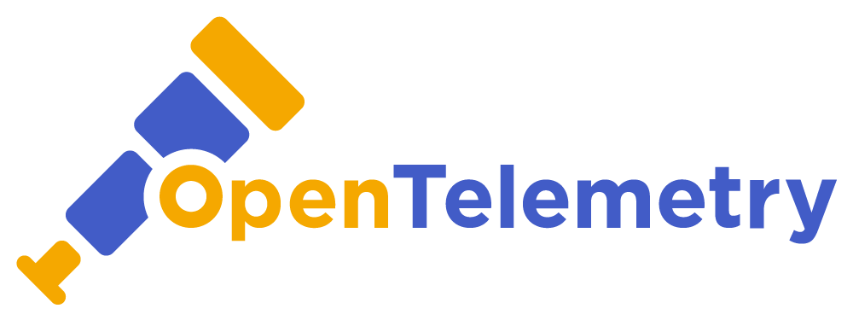
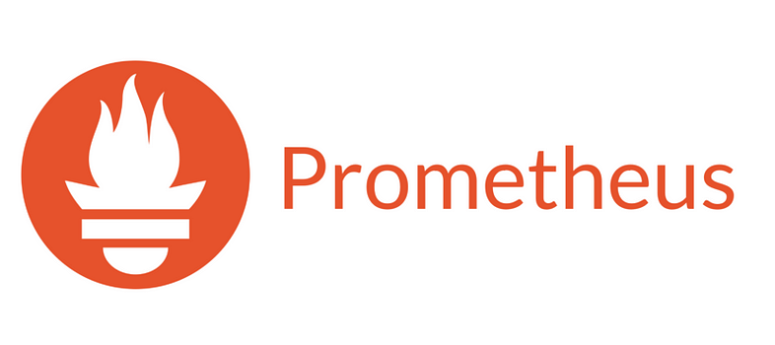

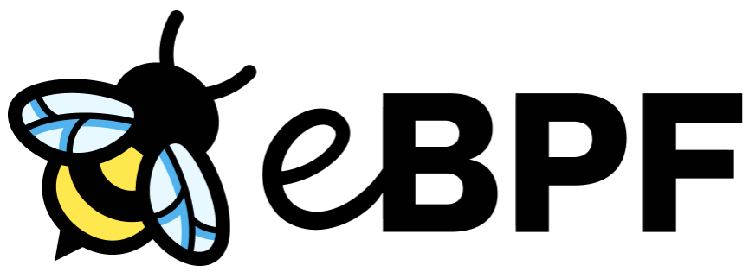




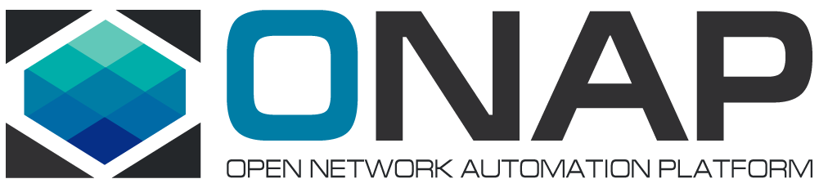


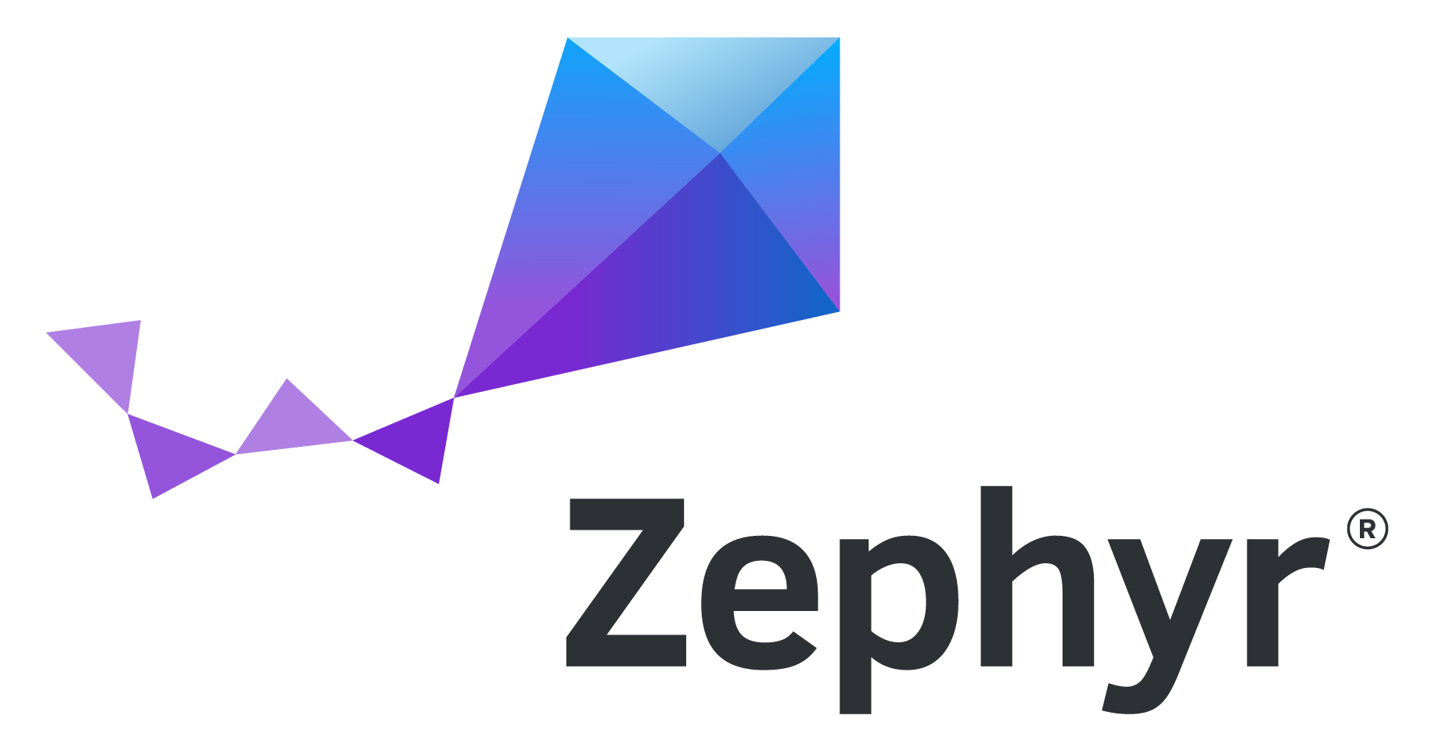

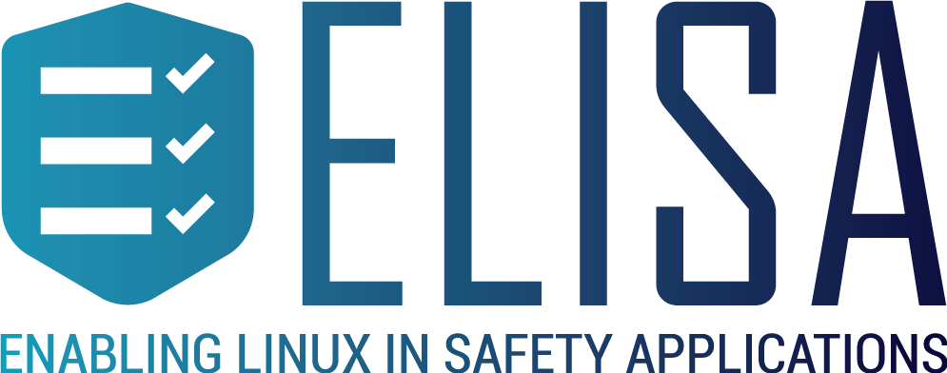
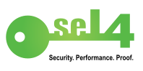

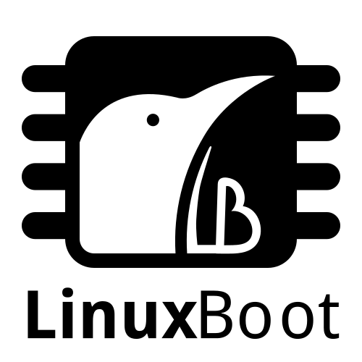

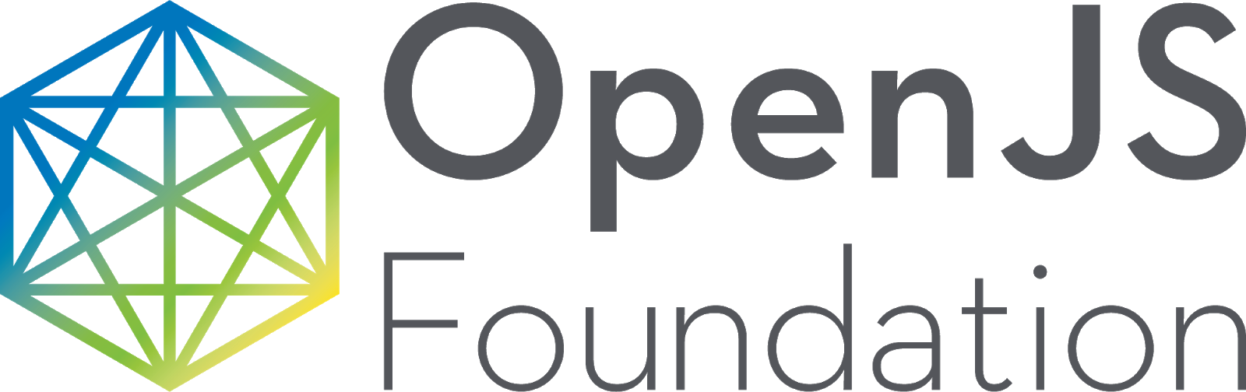
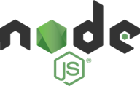



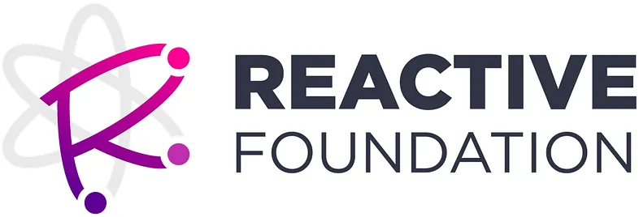

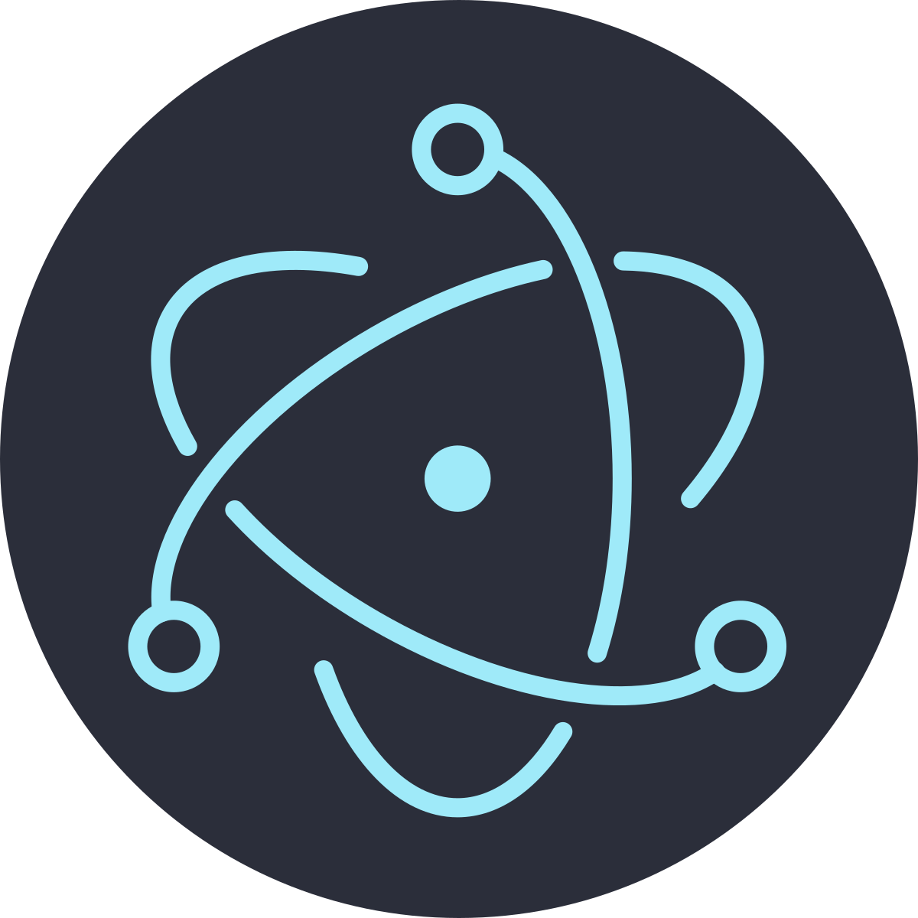
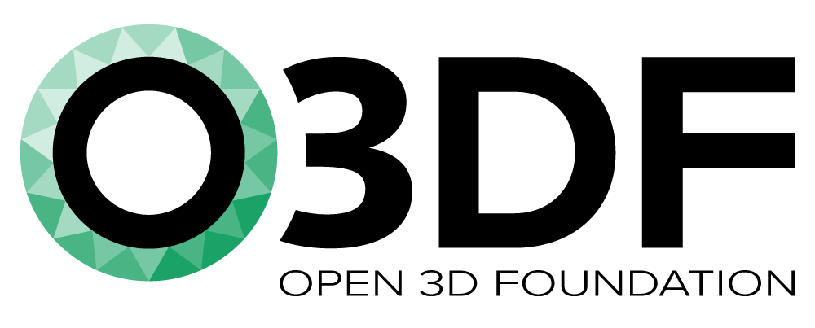
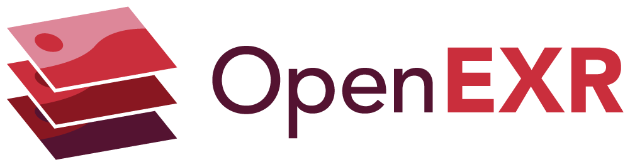


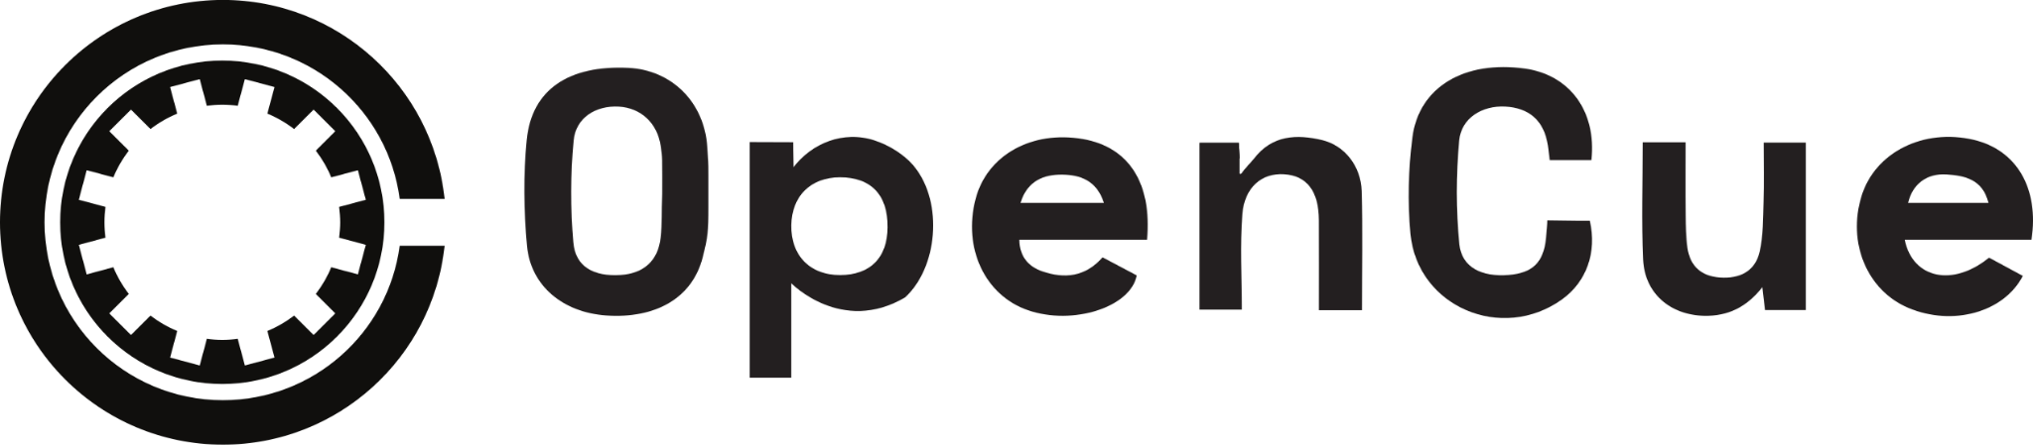



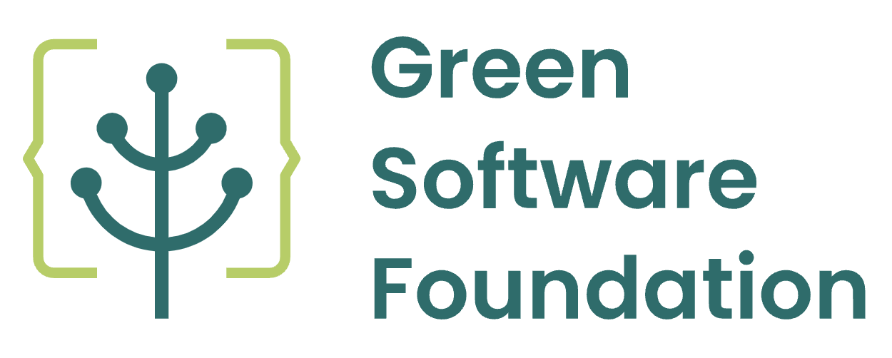
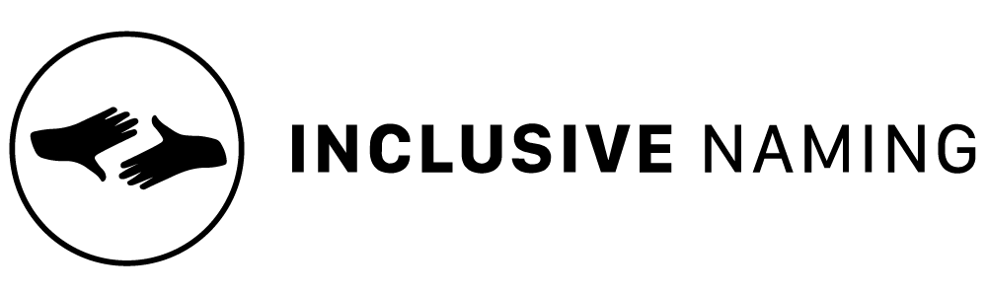


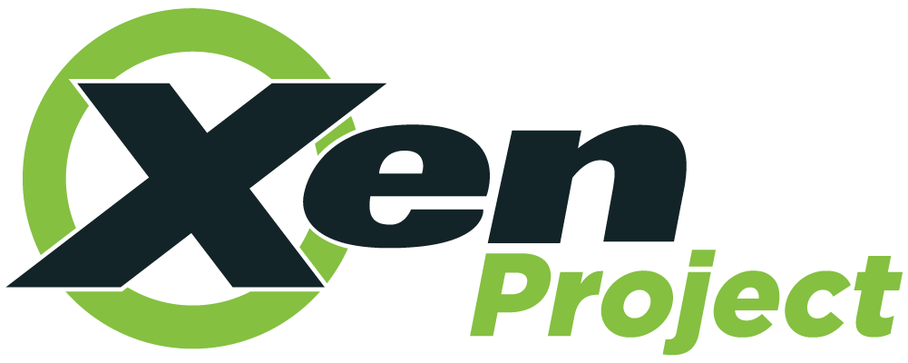
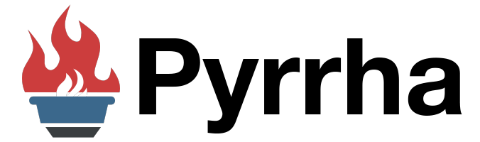


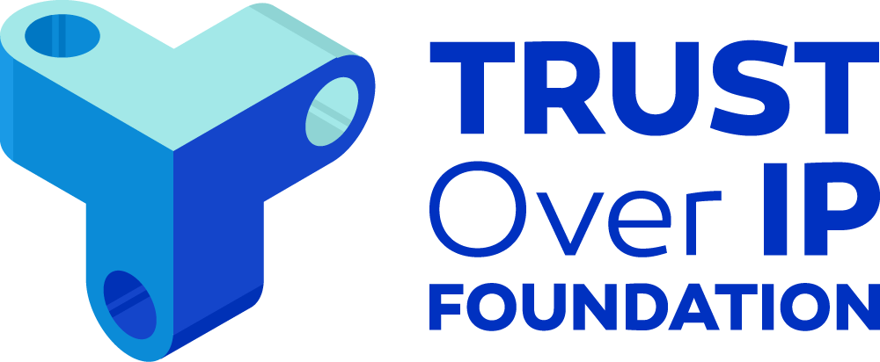

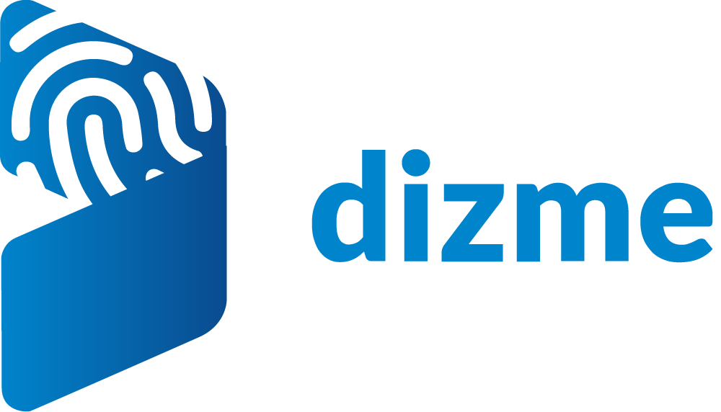


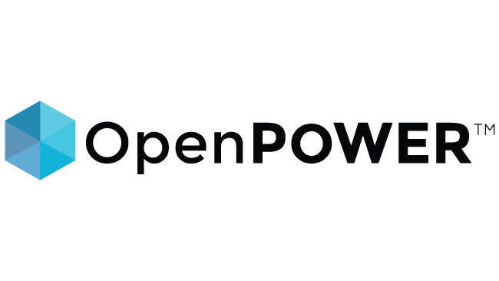
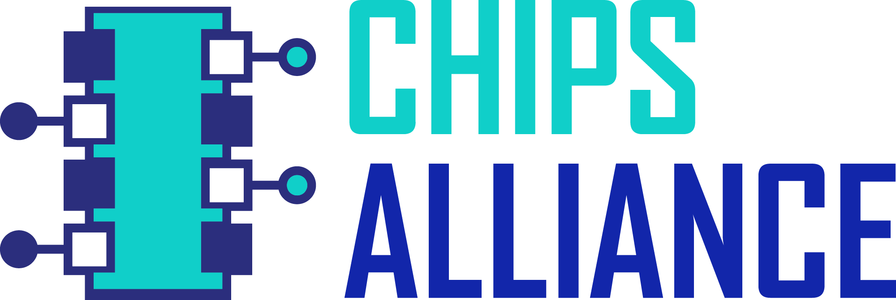
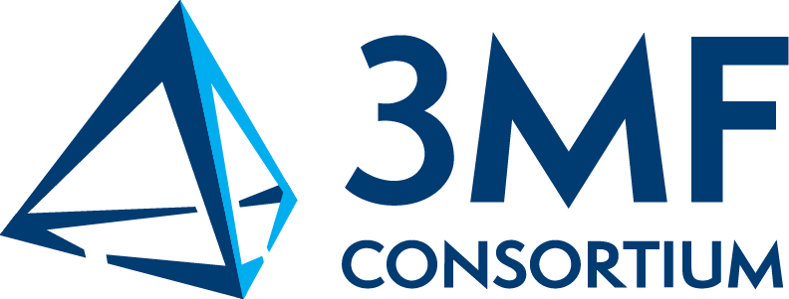








We are behind some of the most critical projects in the world
Vertical Industry
Security
AI & Data
Cloud
Networking
Edge & IoT
Web
Visual Effects
Sustainability
Digital Trust
Hardware
Standards
LinuxBoot
Electron

Slide 23

Landscape of Open Source Projects Only on Mainframe
Source: https://landscape.openmainframeproject.org/fullscreen
Notes:
The ecosystem of open source on mainframe continues to grow, thanks to the work of the open source community on mainframe.
Source: https://landscape.openmainframeproject.org/fullscreen

Slide 24

Broad Open Source Supported on Mainframe
Source: https://landscape.openmainframeproject.org/?group=open-source-ecosystem
Notes:
Further, the open source community on mainframe is ensuring broad open source is supported on mainframe, which is the key piece for forward thinking organizations to realizing the mainframe’s benefits in their computing infrastructure.
Source: https://landscape.openmainframeproject.org/fullscreen/open-source

Slide 25
Open Mainframe Project Enables Innovation

Slide 26




Enabling Innovation by Connecting z/OS to Enterprise Devops
Modernize integration with z/OS based applications and services
Bridge the talent gap by enabling modern development stacks on z/OS
Lack of cross-enterprise testing tools that properly supported z/OS.
Open source support for z/OS was vendor-centric and development efforts disconnected.
2018 Open Mainframe Project added Zowe from contributions from Broadcom, IBM, Rocket Software
2019 Zowe reached 1.0, launched Zowe Conformant to enable downstream ecosystem; investments in collaboration, ecosystem development, and infrastructure
2020 Ambitus joins the Open Mainframe Project
2022 Zowe 2.0 release
2023 Galasa joins the Open Mainframe Project
2024 z/OS Open Tools joins the Open Mainframe Project as zopen community
60,000+ Commits, 1000+ contributors all time
85% of mainframe customers using Zowe in or planning to use Zowe by end of 2024 ( source Arcati Mainframe Yearbook 2024 )
50+ Zowe Conformant offerings, 3 Zowe Conformant Support Providers, 7000+ completed Zowe training offered by Interskill
New project contributions from BMC, Phoenix Software, Vicom Infinity, and multiple customers, has grown codebases of these projects.
Notes:
Let’s see how this is happening today. Enter Zowe, the first open source project launched on z/OS.
Zowe is focused modernizing integration with z/OS based applications and services, and at the same time bridging both the talent and tooling gaps. Launched in 2018, Zowe is gaining mindshare in DevOps and being leveraged by forward thinking organizations globally, shifting the perception of mainframe from a “legacy” platform to a “growth” platform.

Slide 27




Enabling Innovation by Modernizing COBOL
COBOL talent is critical to our society, and the need has amplified in the COVID-19 pandemic.
Enabling the next generation to have COBOL skills done in isolation, causing repeated efforts and lower uptick.
COBOL lacking tools that align with modern development
Launched COBOL Programming Course as an open source project in April 2020, teaching COBOL development using VS Code and Zowe.
Created collaboration forums and ways that COBOL talent can advertise their availability
Launched COBOL Working Group to bring together leaders in thinking about the future of COBOL
COBOL Check project launched, bringing TDD practices to COBOL
Zorse launched to provide a high-quality, openly licensed dataset of COBOL code to train LLMs
“Calling all COBOL Programmers” forum has had over 1.9k individuals make themselves available since April 2020
COBOL Programming Course GitHub repo has 2.5k stars and 500+ forks, along with 22 contributors from several organizations, continuing to evolve with deeper level COBOL training content
COBOL Working Group getting broad feedback on the future direction of COBOL
COBOL Check a step forward in modern dev practices and being integrated into VS Code and COBOL Programming Course curriculum.
Notes:
COBOL hit our collective awareness in the early days of the COVID-19 pandemic, and is identified as a key technology empowering our society. While COBOL was a modern language decades ago, with it being disconnected from other language communities and COBOL skills not being in focus in education, there was a need to move it forward.
Mainframe is where the vast majority of COBOL code is deployed, so the Open Mainframe Project became the natural home for creating a vendor-neutral space for this community. Open Mainframe Project focused on projects that help bring COBOL forward, from the COBOL Programming Course which was launched in the early days of the COVID-19 pandemic and has help hundreds learn COBOL using the development tools of today, to the COBOL Check project that is bringing TDD practices to COBOL development. In addition, thought leader is being driven in the COBOL working group that is aiming to continue pushing COBOL forward.

Slide 28




Enabling Innovation by Creating a Hub for Linux on Z and z/VM Community
Users want to manage their mainframes with the same modern cloud technologies used across the enterprise.
z/VM integration with technologies such as OpenStack have long been a challenge.
Contribution base was IBM only, making it challenging to get wider adoption
z/VM lacked a sustainable hub for community tools and utilities
Linux distributions supporting s390x mainframe
2019 Open Mainframe Project added Feilong
2020 Software Discovery Tool and Tessia added as a projects
2021 z/VM Community Tools forms as a Sandbox project, Linux Distributions Working Group formed
Central repository for open source on mainframe developed, tracking across all major distributions ( http://sdt.openmainframeproject.org )
Sustainable and coordinated maintainership for s390x Linux distributions, including Alma Linux, Debian, Fedora, and openSUSE amongst others.
Central hub being developed for z/VM tools and utilities for easier discoverability.
Notes:
Linux has been part of the mainframe since 1999, which has enabled more and more workloads to shift to mainframe. While from a developer perspective, Linux on mainframe is just like Linux anywhere, there are key technologies such as z/VM which are native to the platform and key to having a unified DevOps approach.
These three projects, ConsoleZ, Feilong, and Tessia, all touch on parts of that story. In the past efforts like this had been driven within IBM, but with the launch of the Open Mainframe Project IBM and the community now have a space for collaborating with customers and vendors to drive an open source solution. In addition, all being a part of the Open Mainframe Project enables closer cooperation between projects.

Slide 29


Enabling Innovation with the Next Generation
Aging tenured mainframe talent, with a growing mainframe talent gap and skills decline in next generation talent.
Needing to help connect students with opportunities in mainframe, aligning the interests in open source.
Isolated efforts in education created duplicated efforts in education.
Launched first mentorship program in 2016 with 7 mentees.
Connected within the mainframe and broad open source community to ensure mentorship work has upstream project value.
Enabled universities to also leverage the program within class work; successful with VCU and Western University (Ontario)
Mainframe Open Education project launched in 2021 to create standard hub of educational materials for mainframe.
70+ mentees completed the program, with broader classwork focus reaching 100s more.
Upstream work has included ports of Alpine Linux, contributions to HyperLedger, OpenStack, CloudFoundry, Kubernetes, and more.
Several mentees are now employed in mainframe roles with IBM, SUSE, ADP, and more.
Collaborations between Broadcom, IBM, Kyndryl, and more have built a base of common mainframe educational materials, free to use and openly licensed.
Notes:
The mentorship program was started in 2016, and has brought an influx of students and new open source code into mainframe. It has also helped companies find talent, and academic institutions showcase talent to organization looking to hire.

Slide 30



Sustainable home for critical mainframe open source efforts.
CBT Tape, a staple of mainframe programmers and operators for over 50 years, lacked a sustainable home and infrastructure to support it.
GenevaERS development was stalling internally at IBM, and needed a home to bring together more constituents and build a community around.
“Mainframe Modernization” loosely defined, causing marketing confusion.
CBT Tape and GenevaERS join the Open Mainframe Project in 2020.
Modernization WG launched in 2022
Strong contributor base to both projects.
CBT Tape gained mainframe infrastructure for development and testing, which has gained more contributors since joining.
Modernization WG defining modernization patterns for consistent, vendor-neutral education.
Notes:
The mentorship program was started in 2016, and has brought an influx of students and new open source code into mainframe. It has also helped companies find talent, and academic institutions showcase talent to organization looking to hire.

Slide 31


Enabling Innovation for End-users
Bankdata Open Mainframe Stack
Developer Enablement
Agile / Test Driven Development
Systems Integration/Deployment
Read the Bankdata story at https://www.openmainframeproject.org/blog/2022/12/16/open-mainframe-use-case-bankdata

Slide 32

Innovation Enablement is More than Code
Notes:
Code is not the only way innovation happens. Open Mainframe Project believes in community, and as part of it’s mission creates space and opportunity for that community to grow and thrive.

Slide 33






Enabling Innovation Through Diversity and Inclusion
Read about diversity in mainframe on Open Mainframe Project’s Blog
Watch the “Making our Strong Community Stronger” series on Open Mainframe Project’s Youtube Channel

Slide 34




Enabling Innovation through strong security and IP policies
Good open source projects follow key best practices…
Multiple, unaffiliated contributors
Code review policies
Secure and validated release process
Security minded development
Open Mainframe Project, as well as larger Linux Foundation projects are well tested, have continuous security analysis, and operate in the best practices of open source projects.
OpenSSF Best Practices badges
Routine license scans, including dependency and software supply chain analysis
Security standards and tooling from OpenSSF leveraged

Slide 35




Enabling Innovation by Telling the “Mainframer” Story
Monthly interview series that highlights diversity in mainframe
Showcases why people have mainframe in their careers and their views of the technology and career field
Read and listen at openmainframeproject.org/podcast
Notes:
One key way is through our podcast, “I Am A Mainframer”, which showcases those in this industry from all races, genders, ages, and locales, highlighting the diversity in mainframe and providing insight into where people in this community see the mainframe ecosystem going.

Slide 36





Enabling Innovation by Providing an “Open” Mainframe
Hosted by Marist College, and through the donation of hardware by Broadcom Mainframe Software, the Open Mainframe Project has a mainframe resource available to any open source project looking to support Linux on s390x, z/OS, or z/VM.
Available in Summer 2024. Thanks to these vendors for donations and support.

Slide 37


Enabling Community by Creating New Ecosystems
Zowe Conformance Program enables vendors to showcase their offerings based on Zowe, as well as their capabilities in supporting Zowe end-users.
Zowe Support Provider Conformance Program gives vendors the ability to showcase their Zowe support competencies.
Benefits
Your offering and logo listed in the Zowe Conformant offering directory or Zowe Conformant Support Provider directory and showcased in Zowe outreach materials
Exclusive branding marks to use in your product materials
Participation in the Zowe Advisory Council (ZAC)
PR announcement for new organizations providing offerings
Post a guest blog post on your offering on the Open Mainframe Project and Zowe blog
Fees are waived for Open Mainframe Project members
More details at https://www.openmainframeproject.org/projects/zowe/conformance

Slide 38
Getting Involved in Open Mainframe Project

Slide 39

Contribute to Our Projects - anyone can!
Contribute to an existing project:
Submit a PR with a bugfix or new feature
Pick existing GitHub issue as a sample project
Integrate with a new app / contribute plugin
Help improve project documentation
Submit additional test cases
Join the TSC discussion: dev mailing list, conf calls
Get involved with the TAC or Working Group:
DevOps / CI expertise always useful
Interest / expertise in security especially welcome
Join the TAC discussions: mailing list, conf calls, working groups
More information at tac.openmainframeproject.org/engagement

Slide 40


Make sure you are following us on social!
Follow us on LinkedIn at https://www.linkedin.com/company/the-open-mainframe-project
Follow us on Twitter at https://twitter.com/OpenMFProject
And sign up for the Open Mainframe Project newsletter to keep up to date on project happenings

Slide 41

Member Organizations
Learn more about membership at openmainframeproject.org/join
Notes:
Source: https://landscape.openmainframeproject.org/embed/embed.html?base-path=&classify=category&key=open-mainframe-project-member-company&headers=false&category-header=true&category-in-subcategory=false&title-uppercase=false&title-alignment=center&title-font-family=sans-serif&title-font-size=13&style=clean&bg-color=%230033a1&fg-color=%23ffffff&item-modal=false&item-name=false&size=md&items-alignment=center

Slide 42

Governing Board Representatives
Notes:
https://jmertic.github.io/committee-gallery/open-mainframe-project-governing-board.html

Slide 43

Technical Advisory Council (TAC) Representatives
Notes:
https://jmertic.github.io/committee-gallery/open-mainframe-project-tac

Slide 44


Learn More About the Open Mainframe Project
Discover and participate in any of our 17 hosted projects and working groups at https://openmainframeproject.org/our-projects/
See the breadth of open source on the mainframe at l.openmainframeproject.org
Take part in our upcoming events and webinars at openmainframeproject.org/events
See the latest blog posts and news at openmainframeproject.org/news
Notes:
You can get involved and learn more by...

Slide 45
Why Become a Member?

Slide 46
Becoming an Open Mainframe Project member means your organization is...
a leader in the open source on mainframe community
wants to drive the technical vision of open source on mainframe
a thought leader or aims to be a thought leader in open source on mainframe
bringing solutions to market based on projects hosted at the Open Mainframe Project, and wanting to show your stewardship towards those communities

Slide 47








Leverage Our Industry Presence to Advance Your Thought Leadership.
Through our large audience, extensive media outreach, and with key partnership with publications such as Linux.com, TFiR, TechChannel, and MediaOps, you will be positioned to be a thought leader in open source. Specific benefits include…
Announcement of your membership via press release and social.
Your company logo on both the Open Mainframe Project website and Linux Foundation website.
Guest blog post(s) on the Open Mainframe Project blog on a thought-leadership topics of our choice.
Provide a guest for the “I Am A Mainframer” podcast, hosted by Steven Dickens and Open Mainframe Project
Post one technical article about an open source project you care about to Linux.com, which has over 1 million unique visitors per month.
Support of your announcements with social outreach and quotes from Linux Foundation and/or Open Mainframe Project leadership as appropriate.
Access to opportunities for contributed articles, videos, podcasts, and events
9000+
followers
4500+
followers
1400+ global media articles in 2023

Slide 48


Additional Event Participation Opportunities
One invite to our member-exclusive Linux Foundation Member Summit, which fosters collaboration, innovation, and partnerships among the leading projects and organizations working to drive digital transformation with open source technologies.
Employees at your organization receive a 20% registration discount to eligible Linux Foundation events, such as our Open Source Summit events in North America, Europe, and Japan.
Open Mainframe Project hosts mini-events for members and the community at these events.
A 5% Discount on Linux Foundation Event Sponsorship, including Open Mainframe Summit (7% discount on multi-event Sponsorships). Sponsorships offer a valuable way to reach the community of Open Source Developers, Engineers, C-level Executives, and more.

Slide 49
Join the Zowe Conformance Program
Zowe Conformance Program enables vendors to showcase their offerings based on Zowe, as well as their capabilities in supporting Zowe end-users.
Zowe Support Provider Conformance Program gives vendors the ability to showcase their Zowe support competencies.
Benefits
Your offering and logo listed in the Zowe Conformant offering directory or Zowe Conformant Support Provider directory and showcased in Zowe outreach materials
Exclusive branding marks to use in your product materials
Participation in the Zowe Advisory Council (ZAC)
PR announcement for new organizations providing offerings
Post a guest blog post on your offering on the Open Mainframe Project and Zowe blog
Fees are waived for Open Mainframe Project members
More details at https://www.openmainframeproject.org/projects/zowe/conformance

Slide 50

Showcase your career opportunities in mainframe
Showcase of Open Mainframe Project members who are hiring for mainframe positions
Not a job board - links to each member’s job listings
ACTION: Provide a link to your job listings specific to mainframe positions
https://www.openmainframeproject.org/resources/careers

Slide 51

Host a Mentorship
Open Mainframe Project funds mentorships for students to bring new talent into mainframe through contributions to open source. These mentees have made huge impacts on hosted projects such as Zowe, Feilong, COBOL Programming Course, and more, as well as broad open source projects such as Alpine Linux, CloudFoundry, Kubernetes, and more. More than 1600+ students globally applied for a mentorship in 2024.
Members can provide a mentorship and be a mentor, which is funded by the Open Mainframe Project. This provides a unique opportunity to find new talent.
Contact mentorship@openmainframeproject.org if you are interested.

Slide 52













LFX is a toolkit built to add value to every aspect of open source development. LFX directly supports projects and empowers open source developers to write better, more secure code and grow sustainable ecosystems.
LFX Insights You can’t improve what you don’t measure
LFX Security Open source security is a shared responsibility
LFX Individual Dashboard Measure your impact across the entire open source ecosystem
LFX Mentorship Train future open source leaders
LFX EasyCLA Don’t let contribution policy disrupt development velocity
Additional tools include...
LFX Member Enrollment
LFX Landscape
LFX Community Events
LFX Training Portal
LFX Crowdfunding Support the projects you depend on
LFX Organization Dashboard Company administrators can see all of their organization’s contributions across LF projects.
LFX Project Control Center The limited access beta enables project services to be managed from a portal interface.
Learn more at lfx.dev

Slide 53

Maximize Your Open Source Investment with Training
The Linux Foundation offers training and certification direct from the source, those contributing to the world’s most important open source projects.
As an Open Mainframe Project Silver or Platinum member, you are entitled to 10 vouchers for 100% any…
LF eLearning Class
Certification Exam
eLearning+Certification Exam “Bundle.”
The value is $299+ per course.

Slide 54

Improve Your Open Source Compliance and Practices
As a Linux Foundation member, your in-house counsel has access to the leading vendor-neutral resources in open source compliance, best practices, and training, along with peer collaboration. Specific benefits include…
Your legal counsel’s ability to participate in bi-monthly legal calls.
One invite for your in-house counsel to LF Legal Summit, which helps connect your counsel to their peers at other member companies and advance your organization’s open source licensing, litigation, compliance, and best practices.
Access to a complimentary membership to the TODO Group, which is a forum for discussing best practices and approaches for establishing and managing open source program offices in organizations.
Support from the vast expertise in the Linux Foundation in engaging with open source, and even starting your own open source project(s).

Slide 55

But Most Importantly, You Support Innovation
Our collaborative projects and working groups are successful because of the investment of members funding these initiatives.
Data through 12/31/2022. Source: https://insights-v2.lfx.linuxfoundation.org/open-mainframe-project/trends?selectedDateFilterType=CUSTOMDATES&startDate=Thu%20Jan%2001%202015%2000:00:00%20GMT-0500%20(Eastern%20Standard%20Time)&endDate=Sat%20Dec%2031%202022%2023:59:59%20GMT-0500%20(Eastern%20Standard%20Time)

Slide 56




Drive the Direction of the Foundation Through Platinum Membership
Platinum members are the key stewards of the Open Mainframe Project, and as such hold key leadership positions in the various governance structures. Their investment is key to the sustainability of open source in mainframe.
Specific Benefits include:
Voting seat on the Governing Board, TAC, and Marketing Committee, enabling the member to direct the strategic direction, budget, and priorities of the Open Mainframe Project.
Host an Open Mainframe Project webinar and have a guest on the “I Am A Mainframer” podcast annually, if desired.
Regular meetings to brief on project activities, and an annual membership check-in to review engagement opportunities and provide feedback to project leadership.
First opportunity to participate and drive event and outreach opportunities, and the project will ensure partnership with Platinum Members in relevant events.
Open Mainframe Project leadership will support Platinum Member events, internal open source program efforts, and be available for customer and prospect engagement.
Additional training benefits through LF Training.

Slide 57
Corporate, Academic, Associate Membership Levels
Level | Annual Fee Includes LF Silver Membership | Board Seat | TAC Seat | Marketing Committee | Notes
Platinum | $120,000 | Yes | Voting | Yes | Initial 2-year participant commitment
Platinum End-User | $30,000 | Yes | Voting | Yes | Initial 2-year participant commitment
Silver | 5,000 employees or more = $50,000 2,000 < 5,000 employees = $35,000 1,000 < 2,000 employees = $30,000 500 < 1000 employees = $25,000 100 < 500 employees = $15,000 < 100 employees = $10,000 | 1 per 10 | Non Voting | Yes
Academic | Free | 1 per 10 | Non Voting | Yes | Restricted to academic institutions
Associate | Free | No | Non Voting | Yes | Non-profits, open source projects
To join Open Mainframe Project, go to https://www.openmainframeproject.org/about/join or email at membership@openmainframeproject.com
Listed fees include Linux Foundation Silver membership. If you are already a Linux Foundation Member, reduced pricing is available.
‹#›

Slide 58
Thank You!

